Slide 1
^{2018 Summer Outlook}
Markets Matter
www.ngsa.org

Slide 2
Understanding the Symbols
Upward market pressure
Flat market pressure
Downward market pressure

Slide 3

2018 Summer Outlook: Outline
Looking ahead to Summer 2018
  Market pressure points:
    Weather
    Economy
    Demand
    Storage
    Production
  Wild card factors
  Summer expectations
Summary

Slide 4
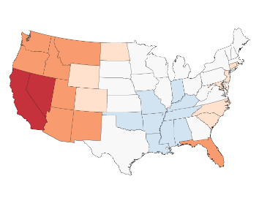
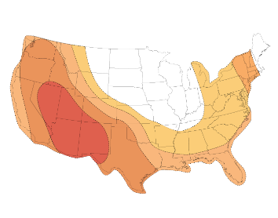
Demand: Summer Weather
LAST SUMMER 2017 (April-October) Actual | THIS SUMMER 2018 Forecast
ACTUAL SEASON (NOAA): 12% cooler than previous summer and 8% warmer than 30-year average 1,328 Cooling degree days (NOAA) | FORECAST: 5% cooler than last summer, 2% warmer than 30-year average 1,256 Cooling degree days
Summer-to-summer pressure on natural gas prices
Data Sources: National Oceanic and Atmospheric Administration, Energy Ventures Analysis

Slide 5
Demand: Economy
SUMMER SEASON Period-to-period change |  | LAST SUMMER 2017 Actual | THIS SUMMER 2018 Forecast
 | Economy | Good momentum | Solid growth
 | GDP growth | 2.3% | 2.8%
 | Unemployment rate | 4.3% | 3.9%
 | Manufacturing | 1.3% | 2.7%
 | CPI | 1.9% | 2.8%
 | Consumer Sentiment Index | 95.7 | 100
 | Summer-to-summer pressure on natural gas prices
Data Source: IHS Economics, May 2018

Slide 6
Demand: Customer Demand
SUMMER SEASON Period-to-period Change |  | LAST SUMMER 2017 Actual | THIS SUMMER 2018 Forecast
 | Customer Gas Demand Electric Industrial Residential/Commercial Pipeline exports- Mexico LNG exports (net) | 69.7 Bcf/d 27.3 Bcf/d 20.5 Bcf/d 10.7 Bcf/d 4.2 Bcf/d 2.1 Bcf/d | 75.9 Bcf/d 30.0 Bcf/d 21.0 Bcf/d 11.5 Bcf/d 4.7 Bcf/d 3.7 Bcf/d
 | Change from previous year | -1.3 % | + 8.9 %
 | Growth sector | Industrial + 3% | Electric + 10%
 | Summer-to-summer pressure on natural gas prices
Data Source: Energy Ventures Analysis, Inc.

Slide 7
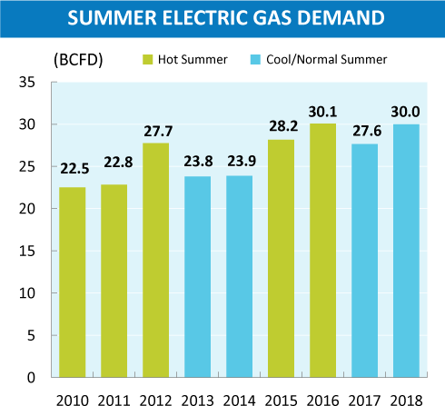
Power Sector: Increased Natural Gas Burn Due to Permanent Structural Change & Some Temporary Price-driven Switching
Compared to last summer
  Additional 10.6 GW of new natural gas capacity (approximately 2 Bcf/day)
Some temporary price-driven fuel switching to natural gas
  More than 2017 when $2.97/MMBtu;
  Less than 2016 when $2.56/MMBtu
Data Source: Energy Ventures Analysis, Inc.

Slide 8
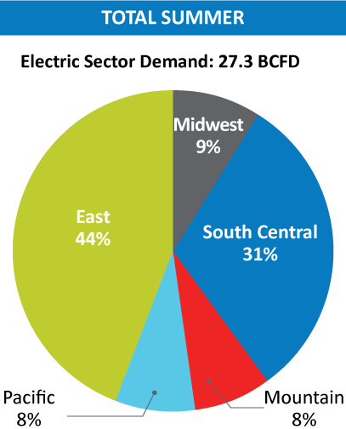
Regional Breakdown: Demand from Power Sector for Summer Cooling Season April-September 2017 v. 2018
2017 LOOK BACK
2018 LOOK FORWARD
Added 6 Gigawatts (GW) new gas-fired capacity in East
Nearly 2.5 GW added in South Central
About 2 GW added in Midwest
Low hydro in Southwest to boost regional natural gas power burn
Data Source: Energy Ventures Analysis, Inc.

Slide 9

Focus: Industrial Demand Peak Growth Phase
Natural Gas Spurring 76 Major Industrial Projects 2015–2021
>$135 Billion
Investment to Build
Increase of 3.4 Bcf/d by 2021
32
Projects
2015-2017
1.4 Bcf/d
Total Natural Gas Demand
44
Projects
2018-2021
2.0 Bcf/d
Total Natural Gas Demand
Photo courtesy: Chevron U.S.A. Inc., 2017 (Pascagoula)
Data Source: Energy Ventures Analysis, May 2018

Slide 10
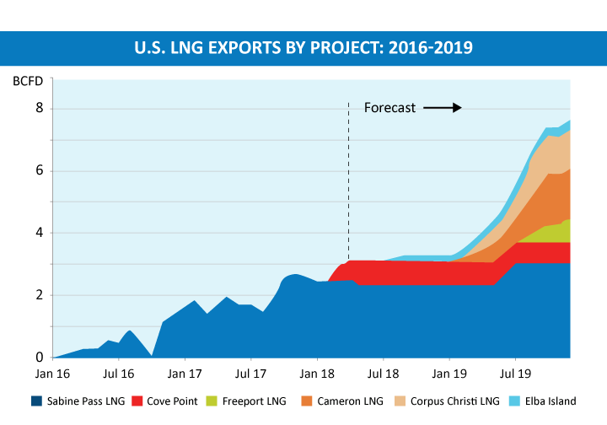
Demand: U.S. LNG Exports Grow as Projects
Come Online 2016-2020
Note: Mexican natural gas supply sources 2011-2020.
Data: Energy Ventures Analysis, Inc., 2018
Data Source: BP Statistical Review, SENER, EVA.

Slide 11
Demand: Summer Storage
SUMMER SEASON Period-to-period Change |  | LAST SUMMER 2017 Actual | THIS SUMMER 2018 Forecast
 | Season starting point | 2,063 Bcf | 1,354 Bcf
 | Average weekly injections | 57 Bcf | 70 Bcf
 | End of injection season | 3,816 Bcf | 3,507 Bcf Projected
 | Summer-to-summer pressure on natural gas prices
Data Sources: Energy Information Administration and Energy Ventures Analysis

Slide 12
Supply: Summer Production – RECORD PRODUCTION
SUMMER SEASON Period-to-period change |  | LAST SUMMER 2017 Actual | THIS SUMMER 2018 Forecast
 | Summer average production (Lower 48) | 72.5 Bcf/d | 80.4 Bcf/d
 | Canadian imports (net) | 5.2 Bcf/d | 5.4 Bcf/d
 | Summer-to-summer pressure on natural gas prices
Data Source: Energy Ventures Analysis

Slide 13
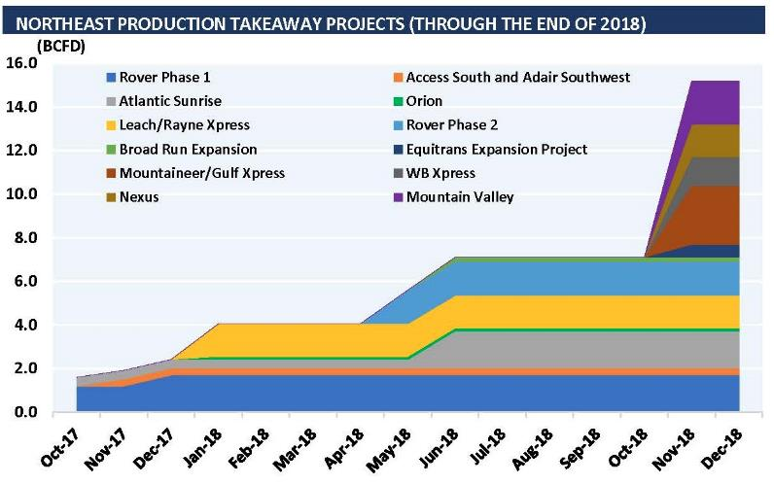
Focus on Supply: Northeast Pipeline Takeaway Capacity to Increase 7-8 Bcf/day
Data Source: Energy Ventures Analysis, Inc.

Slide 14

Summer Outlook: Wild Cards
Forecast for heightened summer hurricane activity
Stable market provides buffer from most
wild cards

Slide 15
This Season’s Summer Outlook
SUMMER SEASON Period-to-period Changev |  | THIS SUMMER 2018 Forecast
 | Weather
 | Economy
 | Overall demand
 | Storage
 | Summer production
 | Summer-to summer pressure on natural gas prices

Slide 16
Natural Gas Outlook: Summer of Flexibility
  Unparalleled production growth
  Associated gas significant contributor due to value of oil, NGLs
  Efficiencies in drilling and production make wells more productive at lower cost
  Pipeline infrastructure expansions provide greater deliverability
Summer (April-October) demand growth
  Driven by new gas generation, exports and unseasonably cool spring
Exports provide growth, stability to market
  Welcome outlet for strong production
Overall, stable natural gas outlook for consumers and a diverse market for producers

Slide 17
About NGSA
Represents major producers and suppliers of
domestic natural gas
  Integrated and independent companies: 14 members
Promotes benefits of competitive natural gas markets, reliable and efficient transportation and delivery, benefiting customers and suppliers of natural gas
Only Washington, D.C. natural gas association with a dedicated focus on downstream gas industry issues
Includes the Center for LNG

Slide 18
EMBARGOED FOR RELEASE THURSDAY, MAY 31, 2018
Contact:
Daphne Magnuson
dmagnuson@ngsa.org
@natgas_ngsa
www.ngsa.org
^{2018 Summer Outlook}
Markets Matter

