Slide 1
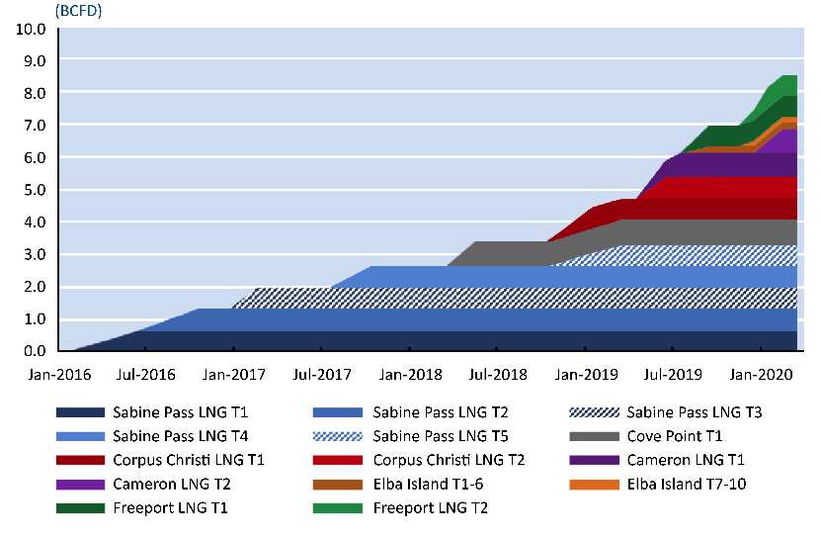
U.S. LNG Exports: First Wave Materializes
Data Source: Energy Ventures Analysis

