Slide 1
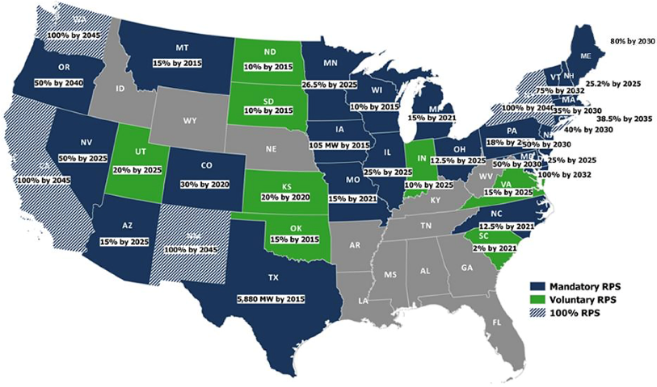
Natural Gas-Renewables Partnership: Path to Clean Energy Future

