Slide 1
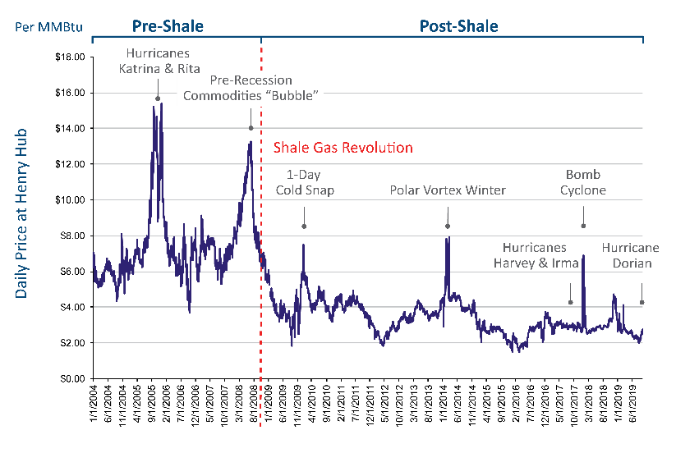
Comparison of Impact of Severe Weather on Daily Prices What a Difference a Decade Makes
Data Source: Gas Daily

